Slide 1
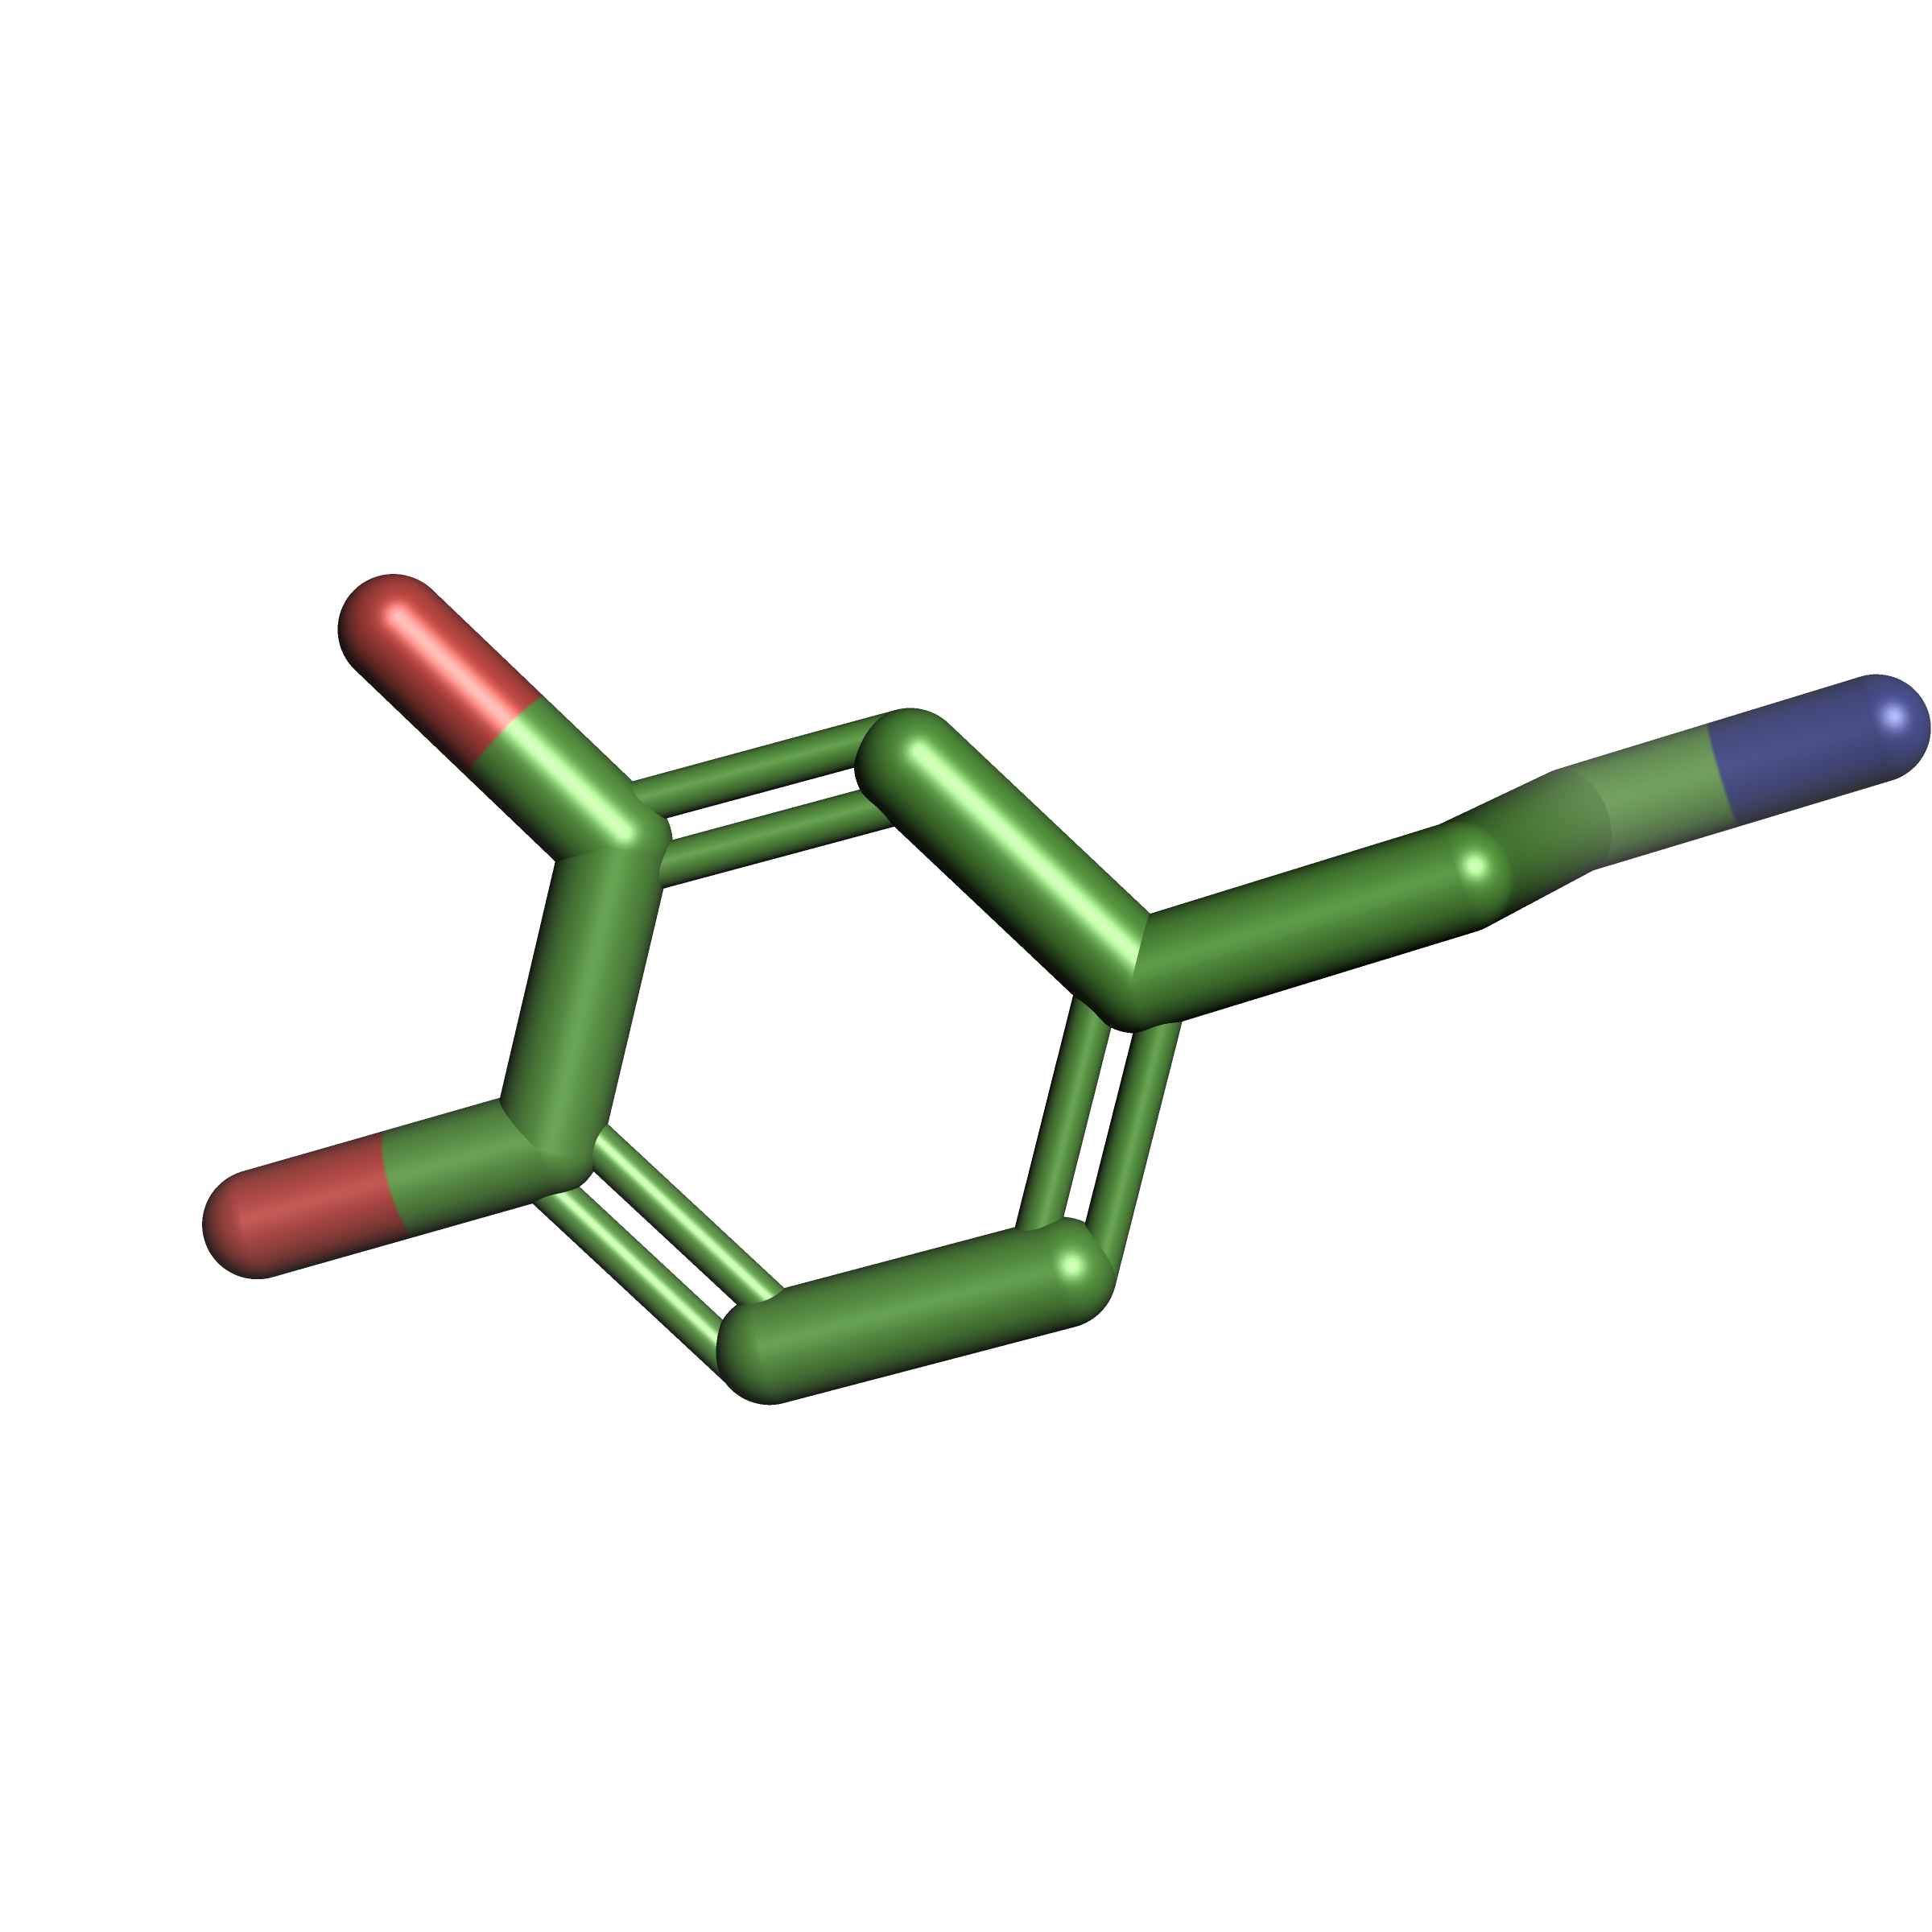
Dopamine molecule – 3D model from ZINC15 database - visualized in PyMOL

Slide 2
>NP_387512.3 D(3) dopamine receptor isoform e [Homo sapiens]
MASLSQLSGHLNYTCGAENSTGASQARPHAYYALSYCALILAIVFGNGLVCMAVLKERALQTTTNYLVVS
LAVADLLVATLVMPWVVYLEVTGGVWNFSRICCDVFVTLDVMMCTASILNLCAISIDRYTAVVMPVHYQH
GTGQSSCRRVALMITAVWVLAFAVSCPLLFGFNTTGDPTVCSISNPDFVIYSSVVSFYLPFGVTVLVYAR
IYVVLKQRRRKRILTRQNSQCNSVRPGFPQQTLSPDPAHLELKRYYSICQDTALGGPGFQERGGELKREE
KTRNSLMPLREKKATQMVAIVLGAFIVCWLPFFLTHVLNTHCQTCHVSPELYSATTWLGYVNSALNPVIY
TTFNIEFRKAFLKILSC

Slide 3
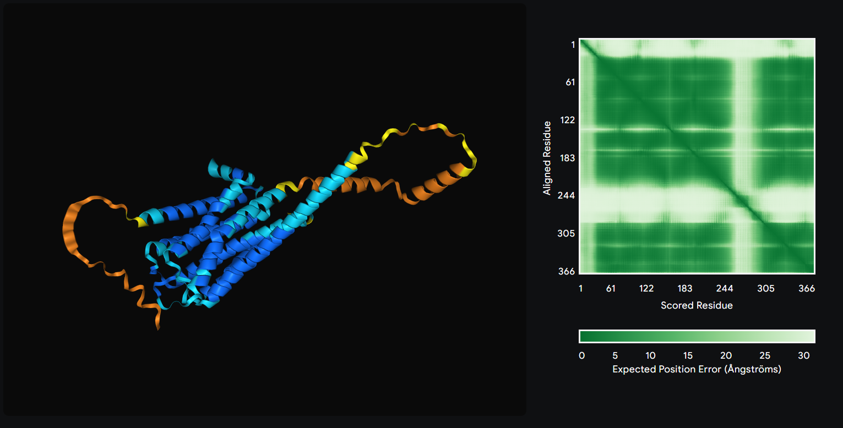
Human Dopamine Receptor isoform 3 - 3D model prediction with AlphaFold3

Slide 4
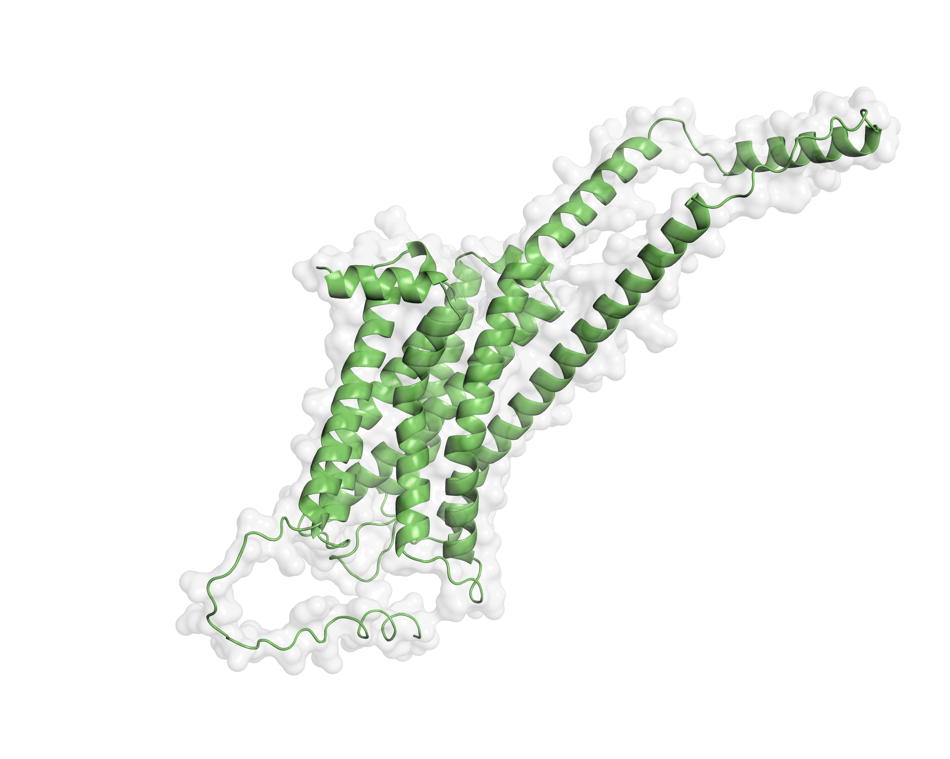
Human Dopamine Receptor isoform 3 – visualization of 3D model (AlphaFold3) with PyMOL

Slide 5
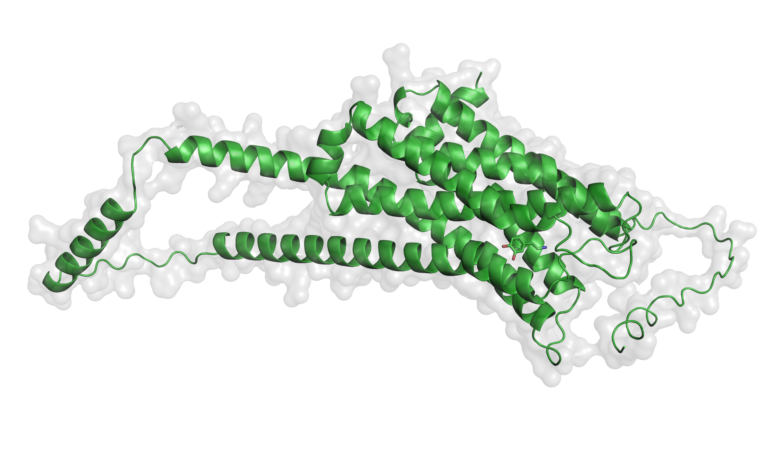
CB-Dock2 docking software link:
https://cadd.labshare.cn/cb-dock2/php/blinddock.php#job_list_load
Complex score: -5.8
PyMOL complex visualization

